Slide 1
Top Down Parsing

Slide 2
Top Down parsers come in two forms
Backtracking parsers
Predictive parsers
Predictive parsers are categorized into
Recursive Descent parsers
Table driven or LL(1) parsers
Both of these use FIRST and FOLLOW sets for constructing lookaheads.

Slide 3
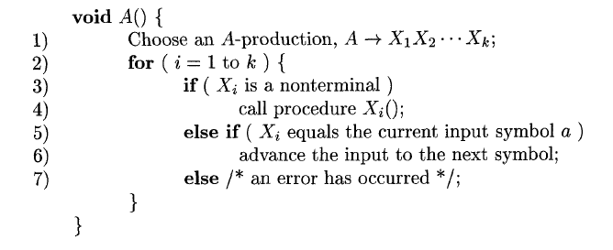
Algorithm for RD parser

Slide 4
Example of RD parser
E→ num T
T→ *num T| ϵ
Input string: 3*4

Slide 5
Procedure E()
{
If lookahead=num then
{
Match(num);
T();
}
else
error;
if lookahead=$
{
declare success;
}
else error;
} /*end of E*/

Slide 6
Procedure T()
{
If lookahead=‘*’
{
match(‘*’);
if lookahead=‘num’
{
match(num);
T();
}
else error;
}
else NULL;
} /*end of procedure T*/
Procedure match(token t)
{
If lookahead=t
Lookahead=next_token;
Else
Error
}

